Slide 1
SIGNATURE VERIFICATION SYSTEM
B M UDAY KUMAR

Slide 2
SYSTEM OVERVIEW
Lets see the overview of the presentation :
Introduction
Problem Statement
Objective
System architecture
RNN
LSTM
CNN
DJANGO
Training process
Web app features

Slide 3
INTRODUCTION
1
2
The rise of digital documentation has led to increased instances of signature forgery.
Authentic signatures are critical in various fields, including finance, legal, and personal identification.
KEY ISSUE
THE NEED
Existing products falls short in areas like speed and reliability
We need a automated and at the same time an reliable system

Slide 4
Ob jectives
Develop three distinct models (RNN, CNN, LSTM)
Create a user-friendly web application
Provide confidence scores alongside predictions
Implement a feature that maintains a history

Slide 5
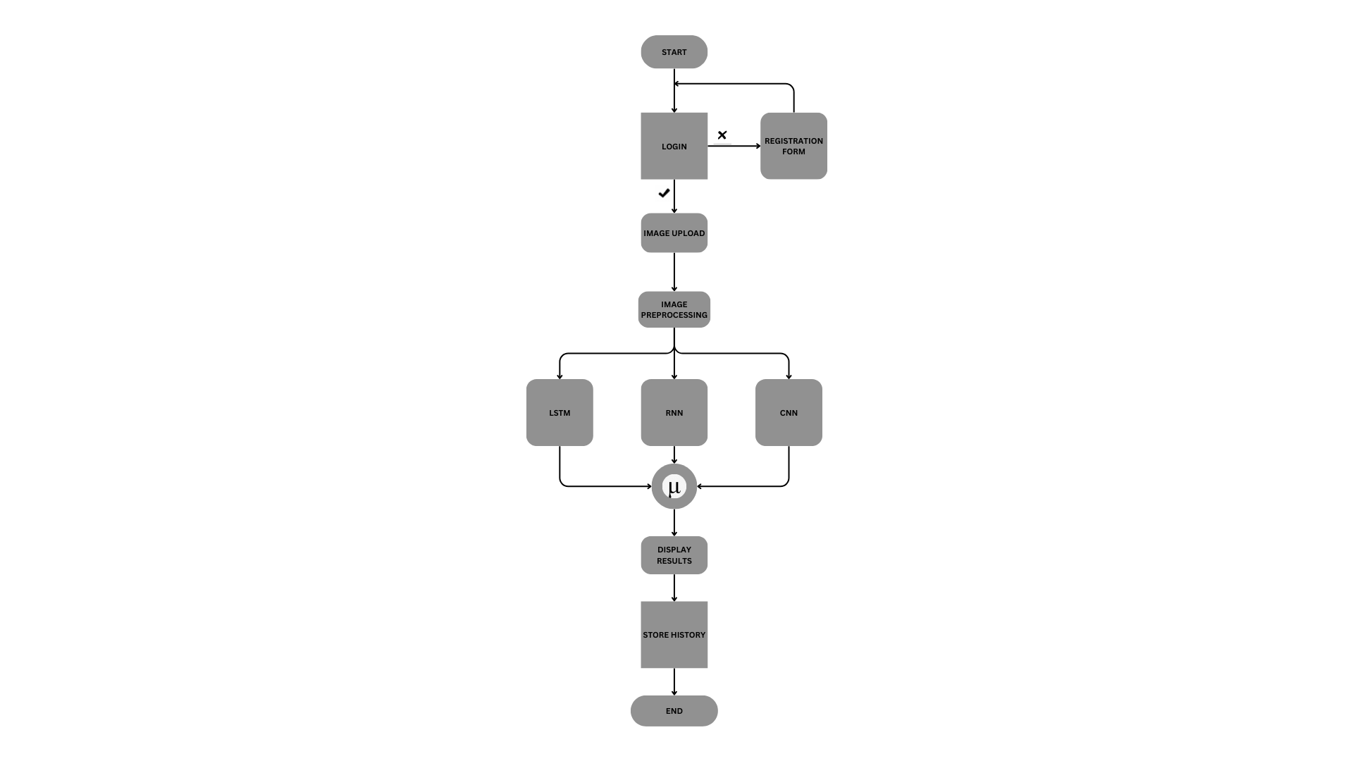
System Architecture

Slide 6
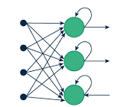
01
RNN
Recurrent Neural Network

Slide 7
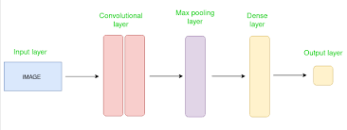
02
CNN
Convolutional Neural Network

Slide 8
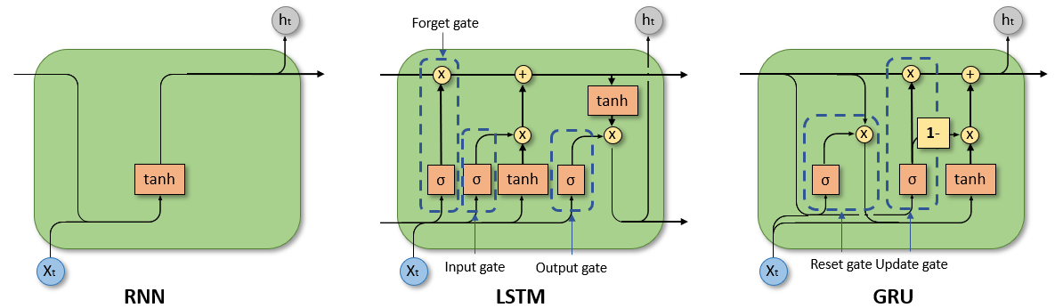
LSTM
03
Long Shot Term Memory

Slide 9
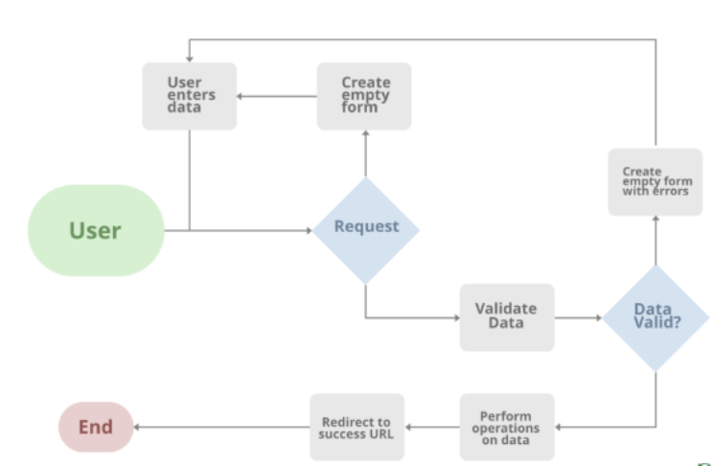
DJANGO
FEATURES:
1. fast
2. Tons of packages
3. secure
4. scalable
5. versatile

Slide 10
Comparison Graph
CNN > LSTM > RNN
CNN
RNN
LSTM

Slide 11
Training Process
Phase 1 Phase 2
Phase 3 Evaluation
Model Training
Training Results
Data Preprocessing
Hyperparameter Tuning

Slide 12




THE WORKFLOW
Log in
Upload pic
Results
History
DJANGO BASED
SECURE FILE UPLOAD
COMBINES RESULTS FROM 3 MODELS
STORE THE RESULTS FOR SUTURE REFERENCE

Slide 13
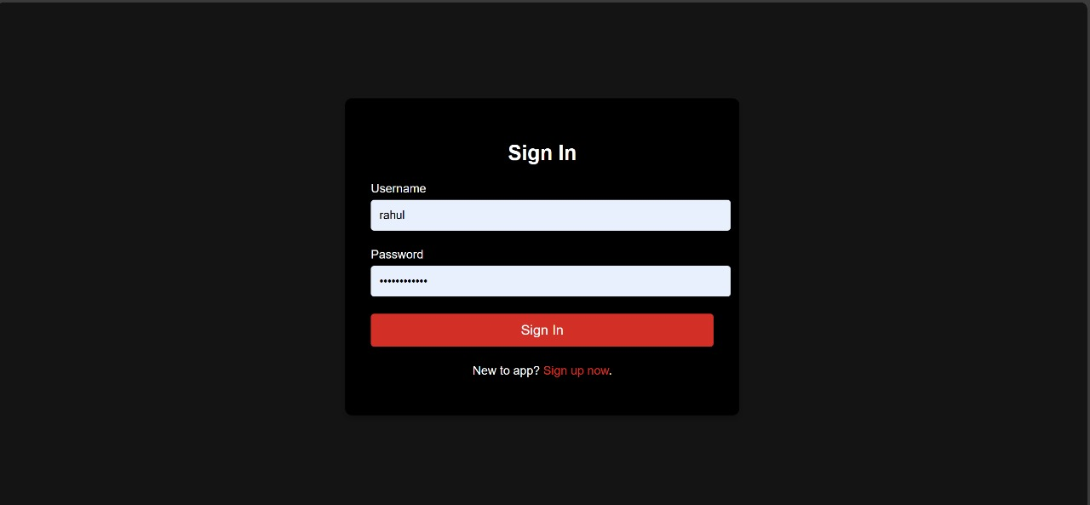
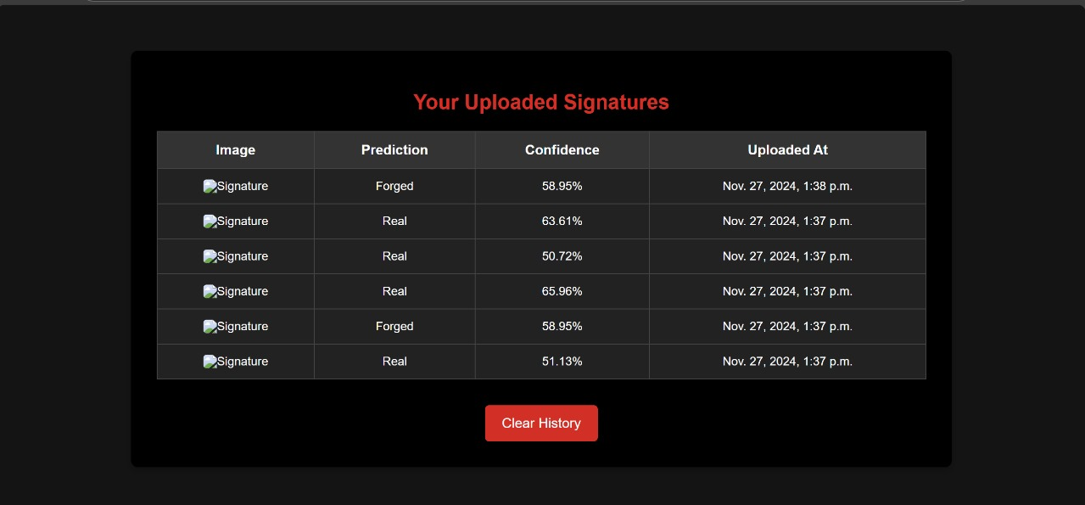
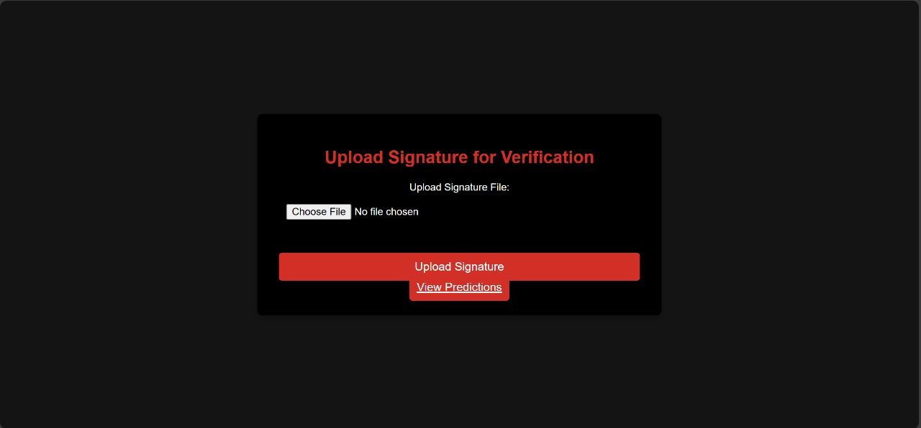
DESKTOP WEBSITE

Slide 14
The key features :
Record logs
User specific
Cloud based
Intuitive UI

Slide 15
THANKS!
THANKS , the product is made with the current problems in mind .

